Slide 1
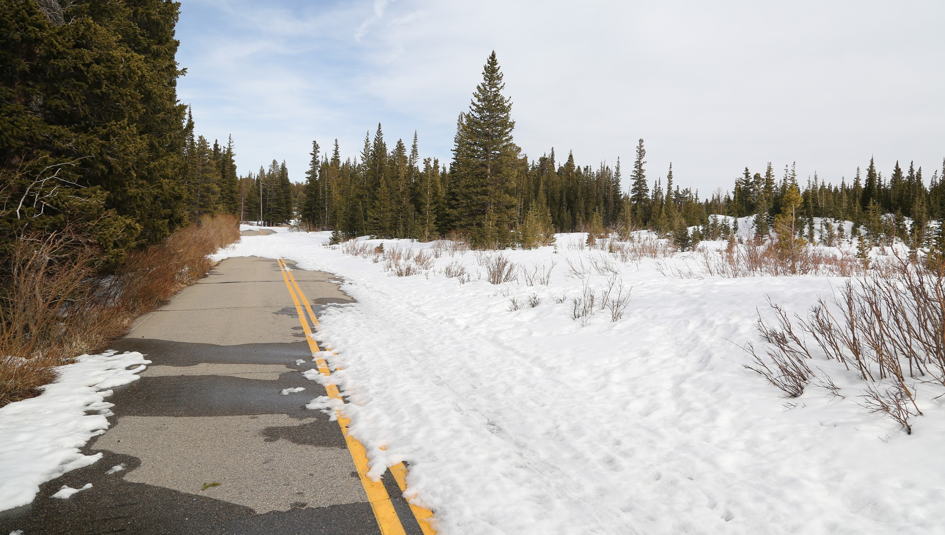
Final Implementation III
The Assignment

Slide 2
White House announces Jerusalem, Palestine embassy opening attendees
The White House has announced the list of attendees at next week's ceremony marking the controversial relocation of the US embassy from Tel Aviv to Jerusalem - with President Donald Trump not being part of the delegation.
Instead, a five-person mission, including Trump's daughter Ivanka, son-in-law Jared Kushner and the US Treasury Secretary Steven Mnuchin, will be present at the opening ceremony on May 14, a White House statement on Monday said.

Slide 3
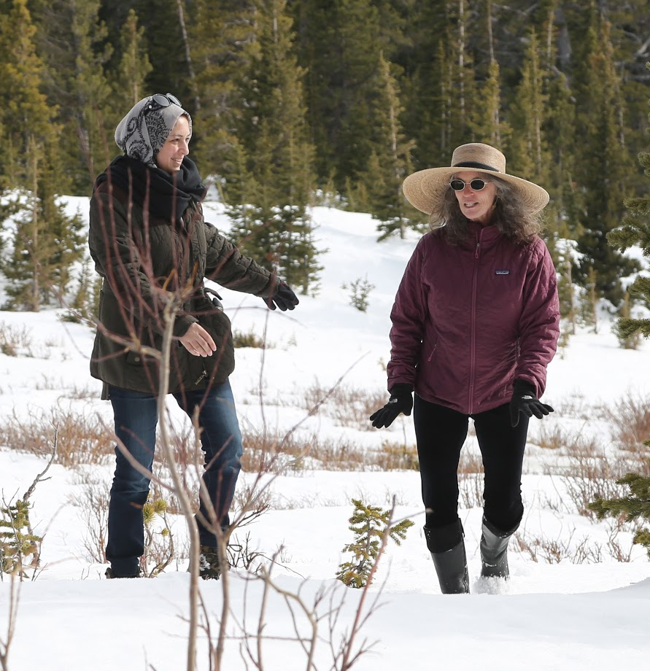
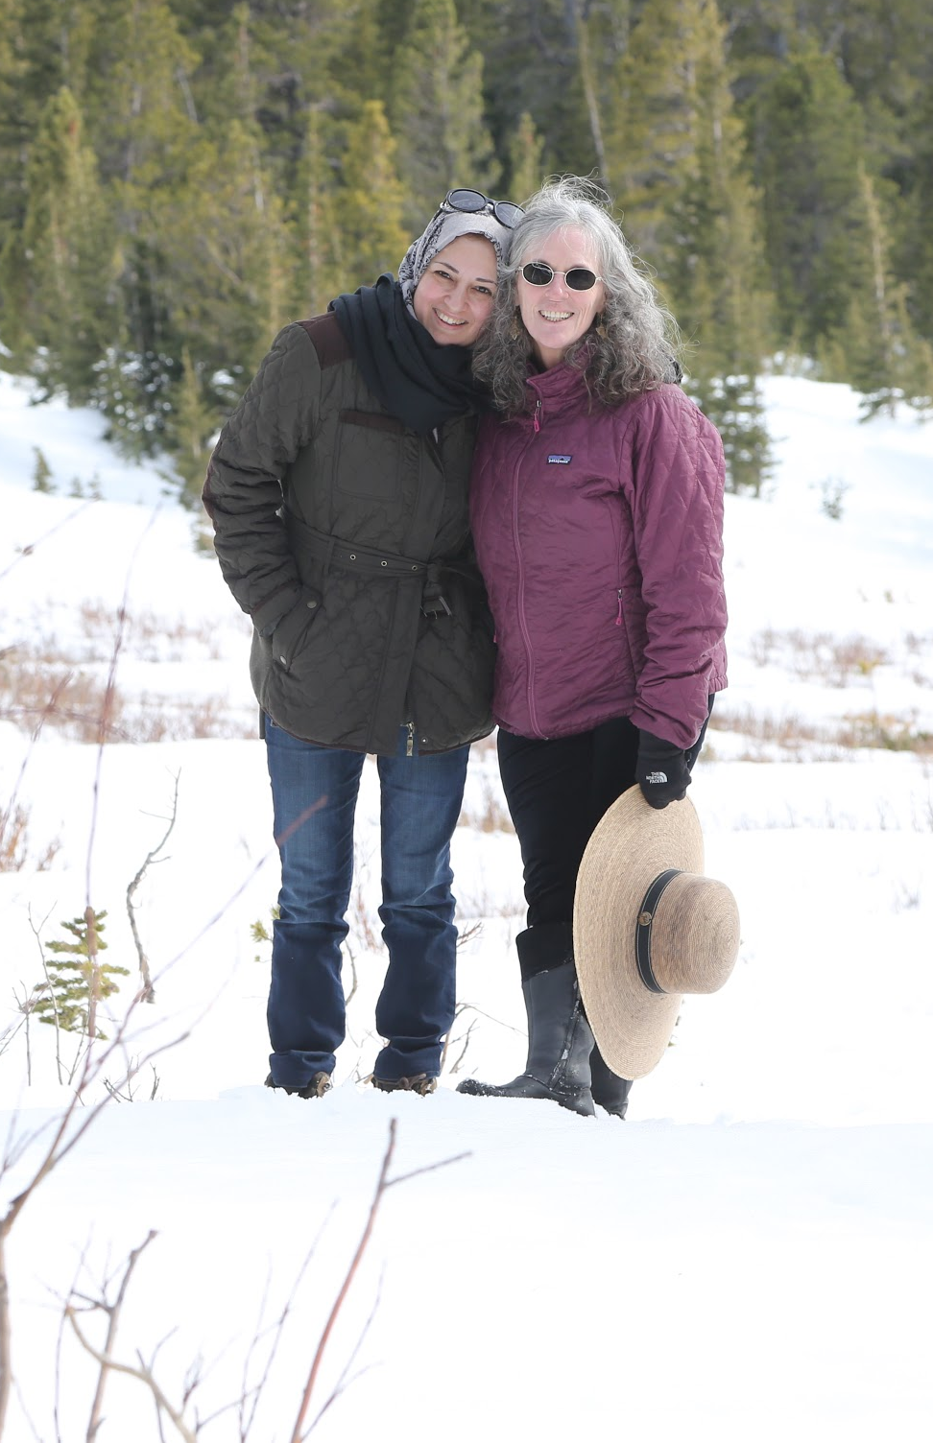

Slide 4
Resizing the root (/) partition:
Since there is currently no free space on the disk, we first have to decrease the size of /home. It is not possible to nondestructively decrease the size of a partition so we first need to backup /home. For safety, make two copies:
cd /home tar -czvf /tmp/home.tar.gz . tar -czvf /nfs/htc-data/`hostname -s`/home.tar.gz

Slide 5
Now we umount /home, remove the /home logical volume, create a new home logical volume, format it with the xfs file system and then remount it.
(That is a lot to do. Please be careful about what you are doing.)
umount /home lvremove /dev/centos_htcXXX/home lvcreate -L 20GB -n home centos_htcXXX mkfs.xfs /dev/centos_htcXXX/home mount -a
Now restore the backed up files to /home and extend the root partition:
cd /home tar -xzvf /tmp/home.tar.gz lvextend -r -l +100%FREE /dev/mapper/centos_htc188-root

Slide 6
The Kludge
When creating a virtual machine, it needs a network connection in order to download the kickstart file. This means that it needs a DHCP server. This presents us with a problem. We can not run an open DHCP server since we are on a campus network. We know this is a bad thing to do because we tried it last week and got in trouble with the campus networking staff. We would prefer to have our own network and more preferably our own private network. Inshallah, we will have an additional network for the class server in about 2 weeks. To “kludge” this problem we will:
Start a VM installation
Disconnect the room from the campus network
Start a local DHCP server
Wait until the installation starts
Turn off the DHCP server
Reconnect the room to the campus network.
Ready
Set
Go

Slide 7
All work will be on htc180
Begin with six tasks:
Configure RAID hardware and set up main server disk
Create VM, and install and configure central web server
Create VM, and install and configure central Puppet server
Create VM, and install and configure central Cobbler server
Create VM, and install and configure central HTCondor manager
Identity and Policy Management (Accounts and passwords)

Slide 8
Class 18 Agenda: The Assignment
Date: May 8, 2018 Objective: Assignments for Final Implementation Create and run KVM Virtual Machine Finish the previous HTCondor Tutorial Directed Acyclic Graphs Doing more on your own
Class 17 Slides: Class 17 - Virtual Machines
Support documents for the in-class work: DAGMan Applications HOWTOs Condor Submit File
In-class documentation: Class 17 - KVM: Virtual Machines

